Slide 1
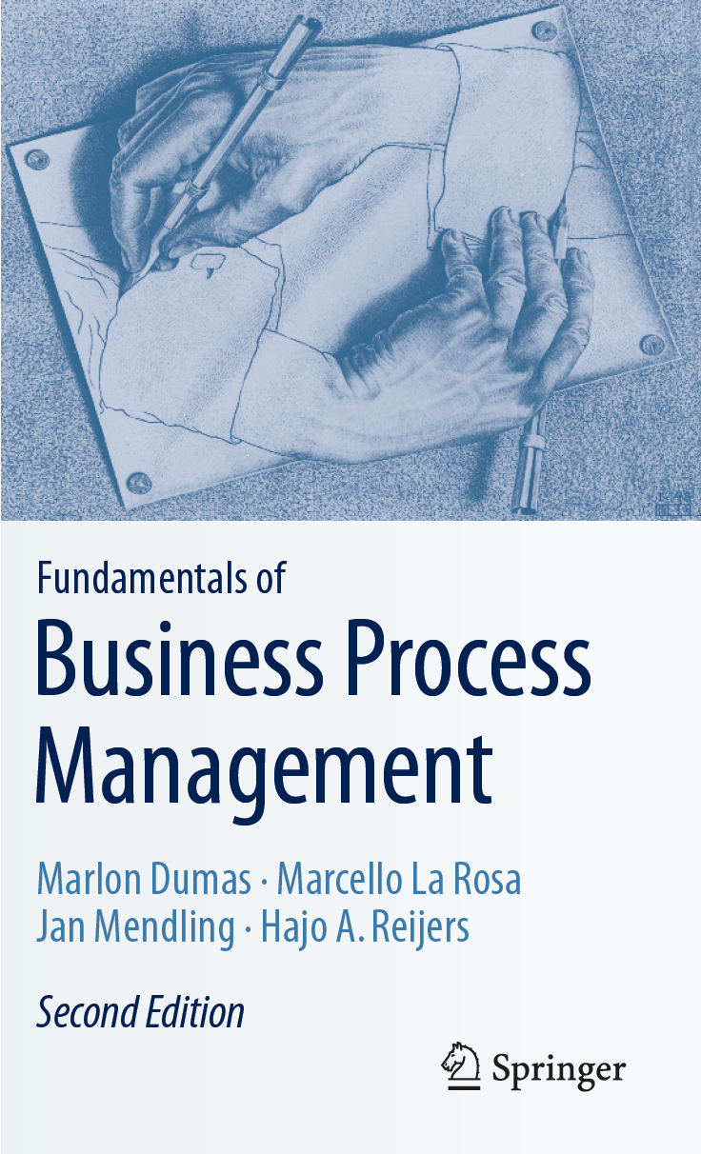
Chapter 2: Process Identification
Contents
The Context of Process Identification
Definition of the Process Architecture
Process Categories
Relationships Between Processes
Reuse of Reference Models
Process Landscape Model
The Example of SAP’s Process Architecture
Process Selection
Selection Criteria
Process Performance Measures
Process Portfolio
Recap

Slide 2

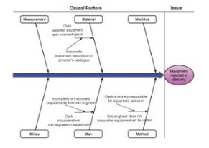
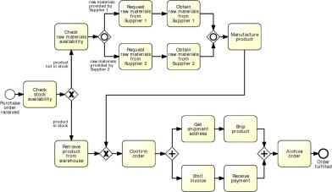
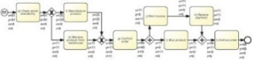
Process Identification in the BPM Lifecycle

Slide 3
Chapter Overview
Process identification refers to systematically defining business processes of organization and establishing criteria to select processes for improvement.
Output is process architecture, which represents processes and interrelations.
Process architecture serves as framework for defining priorities and scope of projects.
First, we discuss the context of process identification.
We present a method based on process architecture definition and process selection.
Definition is concerned with listing initial set of processes and their architecture.
Selection considers criteria for defining priorities of processes using a portfolio.

Slide 4
Chapter 2: Process Identification
Contents
The Context of Process Identification
Definition of the Process Architecture
Process Categories
Relationships Between Processes
Reuse of Reference Models
Process Landscape Model
The Example of SAP’s Process Architecture
Process Selection
Selection Criteria
Process Performance Measures
Process Portfolio
Recap

Slide 5
Definition of Business Strategy
Business strategy is an organizational perspective on setting and meeting business goals. (Mintzberg)

Slide 6
Balanced Scorecard (Kaplan & Norton)

Slide 7
Enterprise Architecture according to TOGAF
Organizational perspective: actors, roles, and organizational structure.
Product perspective: products and services along with their relationships.
Business process perspective: process architecture.
Data perspective: informational entities and their relationships.
Application perspective: different pieces of software with their dependencies.
Technical infrastructure: computer hardware and communication networks.

Slide 8
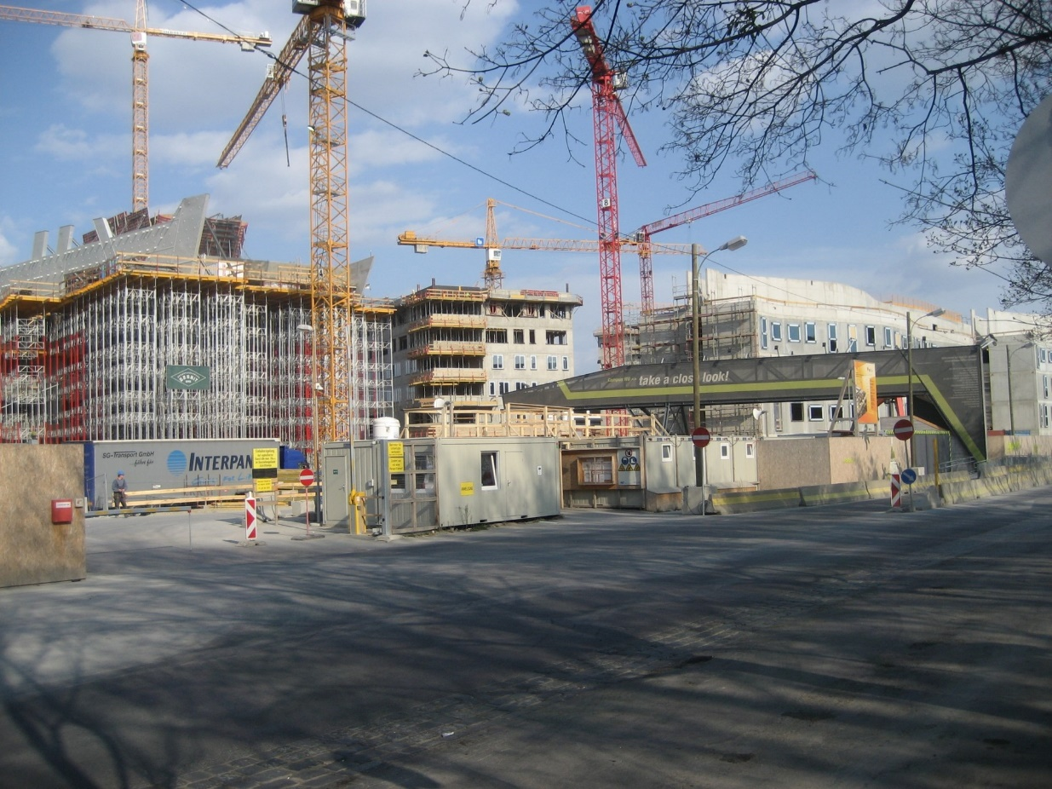
Exercise 2.1: Construction Company BuildIT
Construction Sight of WU Vienna‘s New Campus opened in 2013. Source: Wikimedia Commons

Slide 9
Exercise 2.1-2: Construction Company BuildIT
Consider the construction company BuildIT and its procure-to-pay process that is described on page 2.
To which category in the internal perspective of Figure 2.1 does this process belong?
How does it influence different aspects of the customer perspective?
How is it shaped by aspects of the learning and growth perspective?
Which aspects in the organizational, product, data, application, and technical infrastructure perspectives have to be described to understand this process?

Slide 10
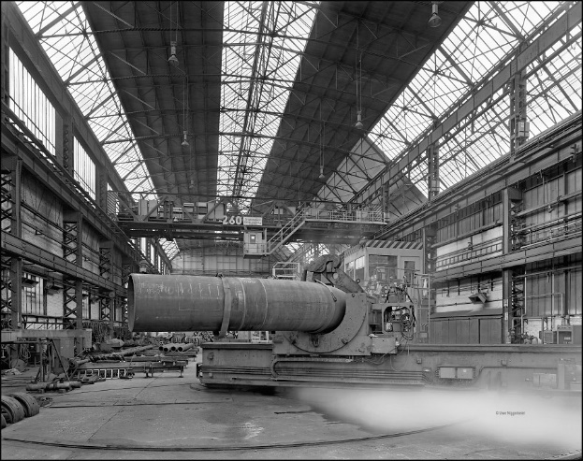
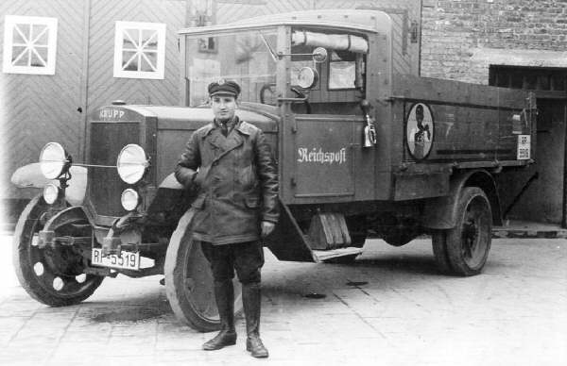
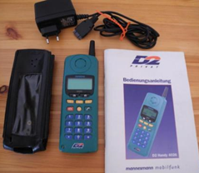
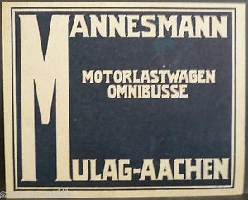


Changes of Strategic Relevance: Mannesmann
19th century 20th century 1990
Sources: stahlseite.de, Copyright Uwe Niggemeier, deutsches-telefon-museum.eu, ebay-kleinanzeigen.de, wanne-eickel-historie.de

Slide 11
The Process Checklist
It may not be easy to decide on what to consider as a business process. A chunk of work that is frequently repeated might not be a business process on its own. To prevent poor scoping decisions, it is useful to consider the following process checklist:
Is it a process at all?
It must be possible to identify main action, which is applied to a category of cases.
Name is of form verb + noun.
Can the process be controlled?
Repetitive series of events and activities to execute individually observable cases.
Without a clear case notion, process management is not feasible.
Also, without any sense of repetition, a group of business activities may better qualify as a project than as a business process.
Is the process important enough to manage?
There is customer who is willing to pay for outcomes,
Organization that carries out the process would be willing to pay another party for taking over, or
Legal, mandatory framework compels an organization to execute it.
Is the scope of the process not too big?
1:1 relation between initial event and activities.
Is the scope of the process not too small?
Rule of thumb: there should be at least three different actors – excluding the customer – involved.
If there are no handoffs between multiple actors or systems, there is little that can be improved using BPM methods.

Slide 12
Chapter 2: Process Identification
Contents
The Context of Process Identification
Definition of the Process Architecture
Process Categories
Relationships Between Processes
Reuse of Reference Models
Process Landscape Model
The Example of SAP’s Process Architecture
Process Selection
Selection Criteria
Process Performance Measures
Process Portfolio
Recap

Slide 13
Process Categories

Slide 14

Exercise 2.3: University
WU Vienna‘s New Campus opened in 2013. Source: Wikimedia Commons

Slide 15
Exercise 2.3: University
What are core, support, and management processes of a university?

Slide 16
Relationships between Processes

Slide 17
Exercise 2.4: Relationships
Can you think of other types of relations that are useful to distinguish between processes?
Hint. Think about the purpose of identifying the relations between business processes

Slide 18
Process Architecture
Generic Process Architecture
British Telecom

Slide 19
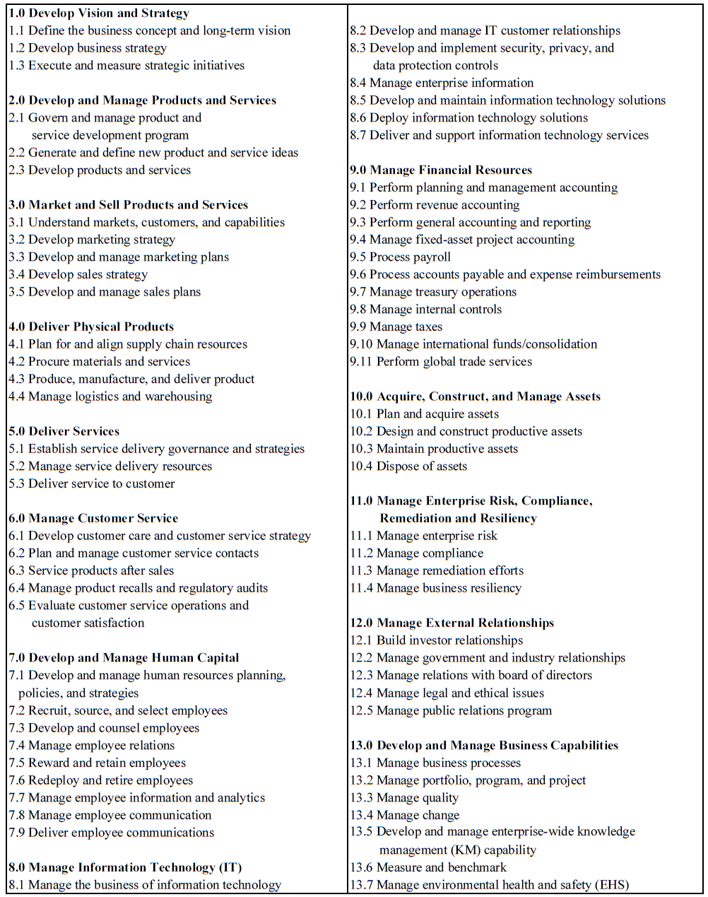
APQC Process Classification Framework

Slide 20
Process Landscape Model: Example of Wienerlinien (Vienna Public Transport)

Slide 21
How to define Process Landscape Model
Clarify terminology:
Define key terms.
Use organizational glossary.
Use reference models.
Ensure that stakeholders have a consistent understanding of process landscape model.
Identify end-to-end processes:
Those processes interface with customers and suppliers.
Goods and services that organization provides are good starting point.
Properties help to distinguish processes, including: Product type, Service type, Channel, Customer type.
For each end-to-end process, identify its sequential processes:
Identify the internal, intermediate outcomes of end-to-end process.
Perspectives help set boundaries: Product lifecycle, Customer relationship, Supply chain, Transaction stages, Change of business objects, Separation.
For each business process, identify its major management and support processes:
What is required to execute the previously identified processes.
Typical support processes are management of personnel, financials, information, and materials.
However, these can be core processes if they are integral part of business model.
Management processes are usually generic.

Slide 22
How to define Process Landscape Model
Decompose and specialize business processes:
Processes of process landscape should be further subdivided into abstract process on Level 2.
Further subdivision until processes can be managed autonomously by single process owner.
Considerations when this subdivision should stop: Manageability and Impact.
Compile process profile:
Each of the identified processes should be described using process profile.
Process profile supports definition of boundaries, vision performance indicators, resources, etc.
Check completeness and consistency:
Reference models can be used to check whether all major processes are included.
Reference models can help to check consistency of terminology.
Check whether all processes can be associated with functional units of organization chart and vice versa.

Slide 23
Exercise 2.5: Construction Company BuildIT
Construction Sight of WU Vienna‘s New Campus opened in 2013. Source: Wikimedia Commons

Slide 24
Exercise 2.5: Construction Company BuildIT
Which APQC categories on Level 1 are relevant for a construction company like BuildIT?

Slide 25
Example 2.2: Construction Company BuildIT
The following passage describes the company BuildIT from a more general perspective. With this information, we will construct its process landscape model.
The overall end-to-end process of BuildIT starts with a customer demand and ends with the expiry of the warranty of construction works. The business development department is responsible for identifying customer demands and public tenders. Together with the presales engineering department, they select projects for which BuildIT prepares bids. Bids that are approved lead to contract negotiations. Once contracts are signed, the contract is transferred to execution. Contract execution starts with the project initiation, which includes engineering, design, and planning. What follows then are the actual construction works. The procure-to-pay process that we already know from Example 1.1 also belongs to these initiation procedures. Once the construction works are finished, the construction sight is commissioned to the customer. What can still follow are corrective works to meet warranty obligations.

Slide 26
Process profile of BuildIT‘s procure-to-pay process

Slide 28
Exercise 2.6: University
WU Vienna‘s New Campus opened in 2013. Source: Wikimedia Commons

Slide 29
Exercise 2.6: University
Create a process landscape model for a university by applying the seven steps described in this section. Use the APQC Process Classification Framework as an aid.

Slide 30
Exercise 2.7: Manageabilty and Impact
Explain how the trade-off between impact and manageability works out for broad and narrow processes, respectively.

Slide 31
Example of SAP Process Map

Slide 32
Chapter 2: Process Identification
Contents
The Context of Process Identification
Definition of the Process Architecture
Process Categories
Relationships Between Processes
Reuse of Reference Models
Process Landscape Model
The Example of SAP’s Process Architecture
Process Selection
Selection Criteria
Process Performance Measures
Process Portfolio
Recap

Slide 33
Selection Criteria
Strategic Importance:
Find out which processes have the greatest impact on the strategic goals.
Consider profitability, uniqueness, or contribution to competitive advantages.
Select those processes for process management that relate to strategy.
Health:
Determine which processes are in deepest trouble.
These processes may profit the most from BPM initiatives.
Feasibility:
Determine how susceptible process is to BPM initiatives, incidentally or continuously.
Culture and politics may be obstacles.
BPM should focus on those processes where it is reasonable to achieve benefits.

Slide 34
Exercise 2.8: Selection Criteria
Exercise 2.8. Consider again the procure-to-pay process of BuildIT (page 2) and the admission process of a university (page 5) as described in Chapter 1.
Discuss their strategic importance, their health, and the feasibility of a potential improvement to these processes.
Further Questions:
Given all the discussed criteria, does an assessment of the importance, health, and feasibility always point us to the same processes to actively manage?
Should all processes that are unhealthy, of strategic importance, and feasible to manage be subjected to BPM?

Slide 35
Process Performance Measures
Performance Measures
Time
Cost
Quality
Flexibility
Performance Objectives
Formulate performance objectives of the process at a high level, in the form of a desirable state that the process should ideally reach, e.g., customers should be served in less than 30 minutes.
For each performance objective, identify the relevant performance dimension(s) and aggregation function(s), and from there, define one or more performance measures for the objective in question, e.g., the percentage of customers served in less than 30 minutes. Let us call this measure ST(30).
Define a more refined objective based on this performance measure, such as ST(30) >99%.

Slide 36
Example 2.3: Restaurant
A restaurant has recently lost many customers due to poor customer service. The management team has decided to address this issue first of all by focusing on the delivery of meals.
The team gathered data by asking customers about how quickly they liked to receive their meals and what they considered as an acceptable wait.
The data suggested that half of the customers would prefer their meals to be served in 15 min or less. All customers agreed that a waiting time of 30 min or more is unacceptable
In this scenario, most relevant performance dimension is serving time.
One objective is to completely avoid waiting times above 30 min.
Percentage of customers served in less than 30 min should be close to 100%.
Thus, the percentage of customers served in less than 30 minutes is relevant performance measure.
Threshold mentioned in scenario is 15 min.
Choice between two performance measures: average meal delivery time or percentage of customers served in 15 min.

Slide 37
Exercise 2.9: Travel Agency
Consider the following summary of issues reported in a travel agency.
A travel agency has recently lost several medium-sized and large corporate customers due to complaints about poor customer service. The management team of the travel agency decided to appoint a team of analysts to address this problem. The team gathered data by conducting interviews and surveys with current and past corporate customers and also by gathering customer feedback data that the travel agency has recorded over time.
About 2% of customers complained about errors that had been made in their bookings. In one occasion, a customer had requested a change to a flight booking. The travel agent wrote an email to the customer suggesting that the change had been made and attached a modified travel itinerary. However, it later turned out that the modified booking had not been confirmed in the flight reservation system. As a result, the customer was not allowed to board the flight and this led to a series of severe inconveniences for the customer.

Slide 38
Exercise 2.9: Travel Agency
Similar problems had occurred when booking a flight initially: the customer had asked for certain dates, but the flight tickets had been issued for different dates. Additionally, customers complained of the long times it took to get responses to their requests for quotes and itineraries. In most cases, employees of the travel agency replied to requests for quotes within 2-4 working hours, but in the case of some complicated itinerary requests (about 10% of the requests), it took them up to 2 days.
Finally, about 5% of customers also complained that the travel agents did not find the best flight connections and prices for them. These customers essentially stated that they had found better itineraries and prices on the Web by searching by themselves.
Which business processes should the travel agency select for improvement?
For each of the business processes you identified above, indicate which performance measure the travel agency should improve.

Slide 39
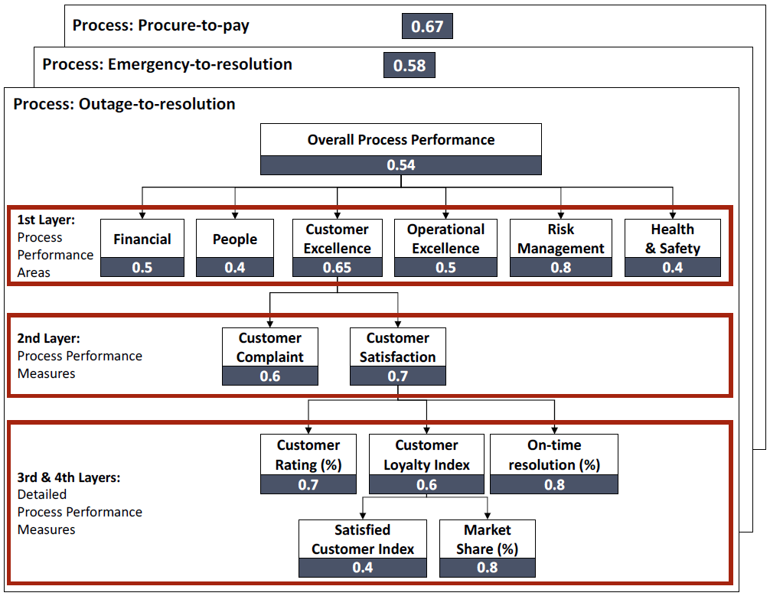
Balanced scorecards with cascading process performance measures

Slide 40
Process Portfolio

Slide 41
Exercise 2.10: University
WU Vienna‘s New Campus opened in 2013. Source: Wikimedia Commons

Slide 42
Exercise 2.10: University
A university defined four core processes in relation to teaching. An evaluation of strategic importance, health, and feasibility using a survey among the department chairs has resulted in the following assessment:
Develop and Manage Study Programs: Importance 90%, Health 90%, Feasibility 40%.
Market Study Programs: Importance 75%, Health 80%, Feasibility 60%.
Schedule Courses: Importance 95%, Health 30%, Feasibility 50%.
Deliver Courses: Importance 95%, Health 70%, Feasibility 30%.
Manage Student Services: Importance 85%, Health 50%, Feasibility 40%.
Manage Facilities: Importance 40%, Health 35%, Feasibility 70%.
Draw a process portfolio and suggest one process to be selected for process improvement. Justify your choice.

Slide 43
Exercise 2.10: University

Slide 44
Chapter 2: Process Identification
Contents
The Context of Process Identification
Definition of the Process Architecture
Process Categories
Relationships Between Processes
Reuse of Reference Models
Process Landscape Model
The Example of SAP’s Process Architecture
Process Selection
Selection Criteria
Process Performance Measures
Process Portfolio
Recap

Slide 45
Recap
In this chapter, we discussed process identification.
Process architecture definition aims at enumerating major processes of organization.
Process architecture defines relationship between processes.
Seven-step method for definition of process architecture including process landscape model.
Process selection is concerned with prioritizing processes.
Priorities upon importance of processes, health, and feasibility of improvements.
Assessed by process owners or grounded on process performance measures and objectives.
Most common performance dimensions are time, cost, quality, and flexibility.
Process portfolios help in selection of processes for improvement.
Selected processes become subject of remaining phases of BPM lifecycle.

